Slide 1
BookInGo
Yash Sharma
2115001158
GLA University,Mathura
Department of Computer Science Engineering
24-11-2023

Slide 2
Introduction
LMS has been developed to override the problems prevailing in practice of manual system.
This application will eliminate the manual work and hardships faced in real time to make it in a smooth, fast and responsive manner.
Basically it will reduce the human efforts and chances of any manual mistakes will be reduced with the help of the application implementation.

Slide 3
Objectives
A web application which will help to reduce the manual work of maintaing all the necessary details of issued books and fast system with error-less data and a system of generating emails once they perform some actions in library with books like(issue a book, return a book, etc).

Slide 4
Problem Statement
The main need for this LMS project will help to manage the details of books which are being issued in real time and managing the data correctly becomes a big challenege manually, as maintaining the records of all the books and books being issued to any specific student for a correct time period and returned back at correct time and management of fine, if not done at right time and a proper system to notify students at proper time for their actions.

Slide 5
Literature Review
Multiple Library Management System are available at real time but this BOOKIngo consist of new feature of notifying the library and student when book is issued and when it will expire.
Just to maintain the real time data in appropriate way.

Slide 6
Methodology
BookInGo implementation will require the below set of tools :
Google AppScript
HTML5
CSS
Visual Studio IDE
Google Sheets
Javascript

Slide 7
System Architecture
BookInGo application is developed with the help of Google AppScript, coding is done in appscript and records of books will be stored in a microsoft excel file that will be working as a database for this application for now.

Slide 8
Features
Storing the records of books in libarary
Notify the students when they issue a book
Provide proper details to students in email
Validation of time period for book validity
Notification for book expiry and fine, if expiry happens.

Slide 9
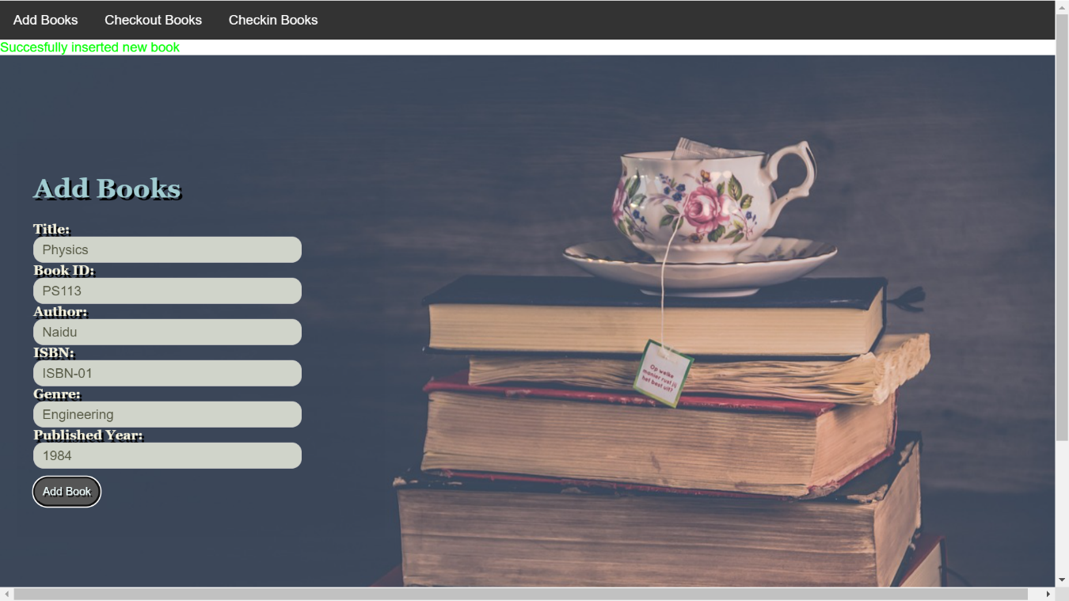
Results/Screenshots
Inserting Books:

Slide 10
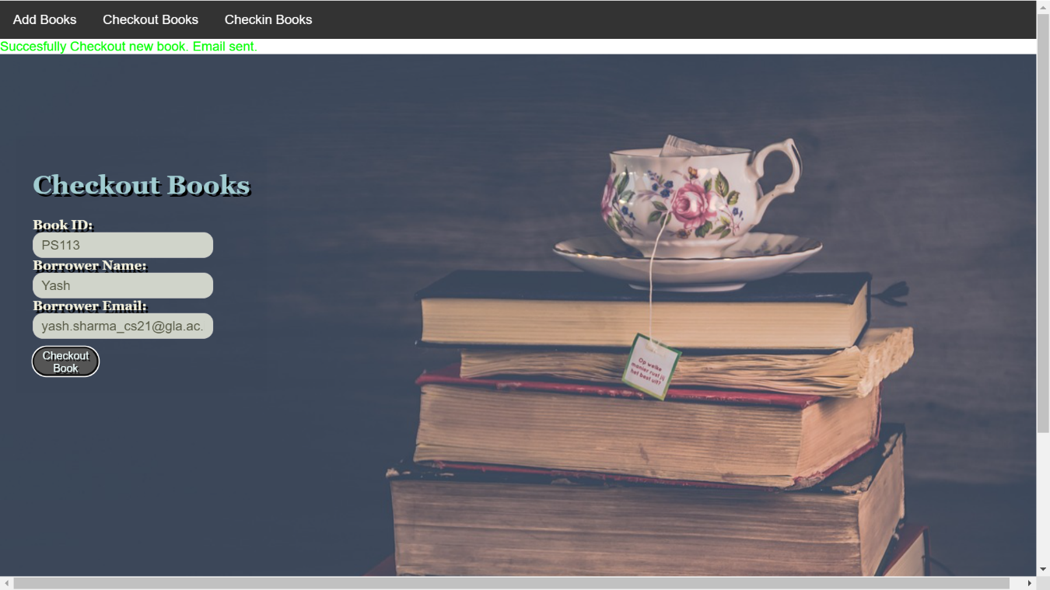
Results/Screenshots
Checkout Book:

Slide 11

Results/Screenshots
Book Already Checked Out:

Slide 12
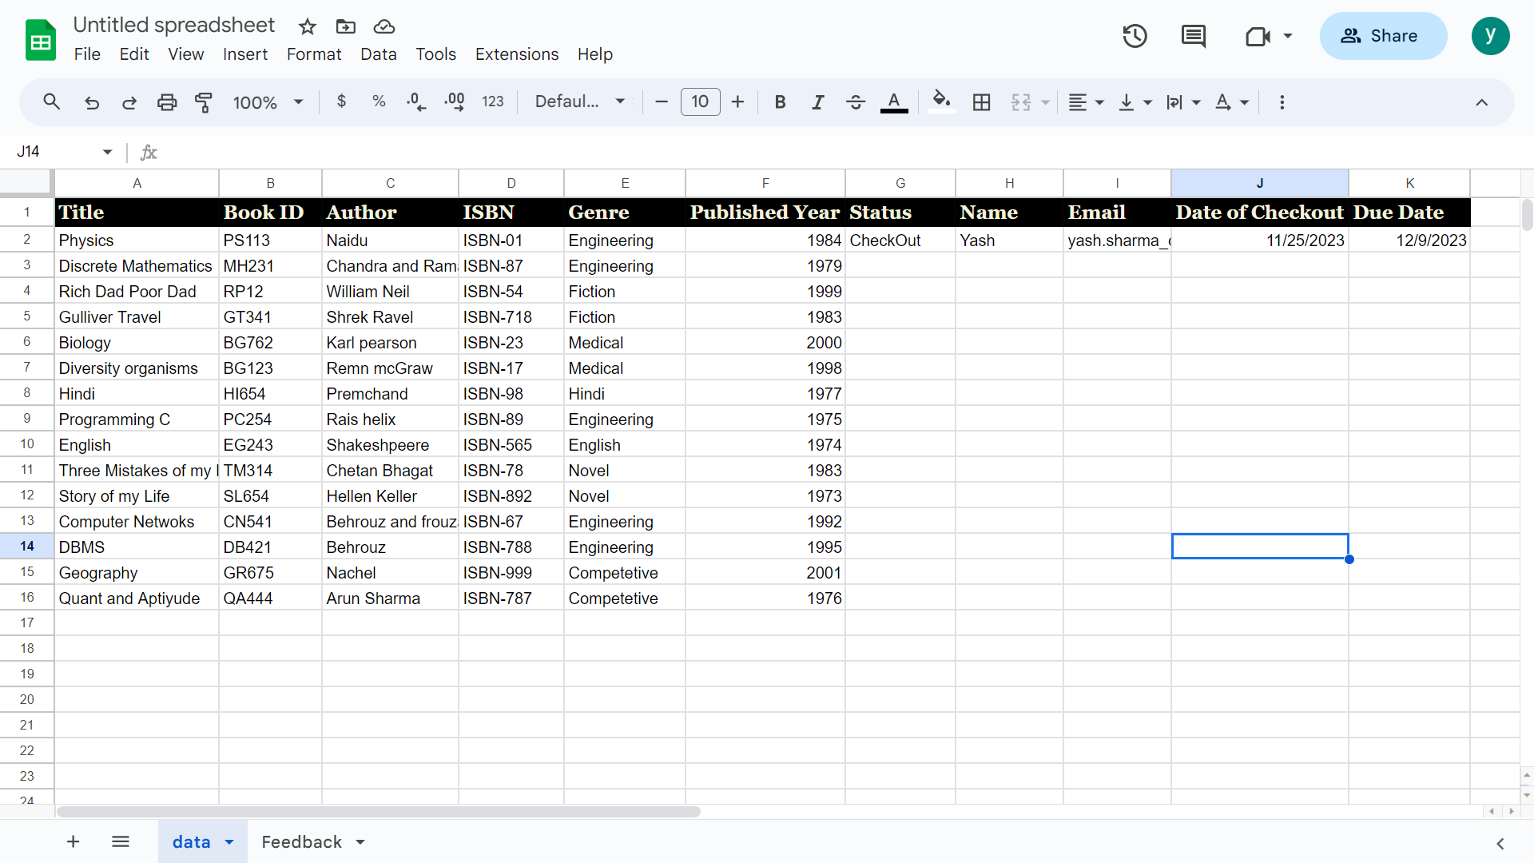
Results/Screenshots
Checkout updated in Google Sheet:

Slide 13

Results/Screenshots
Book not found for checkout:

Slide 14
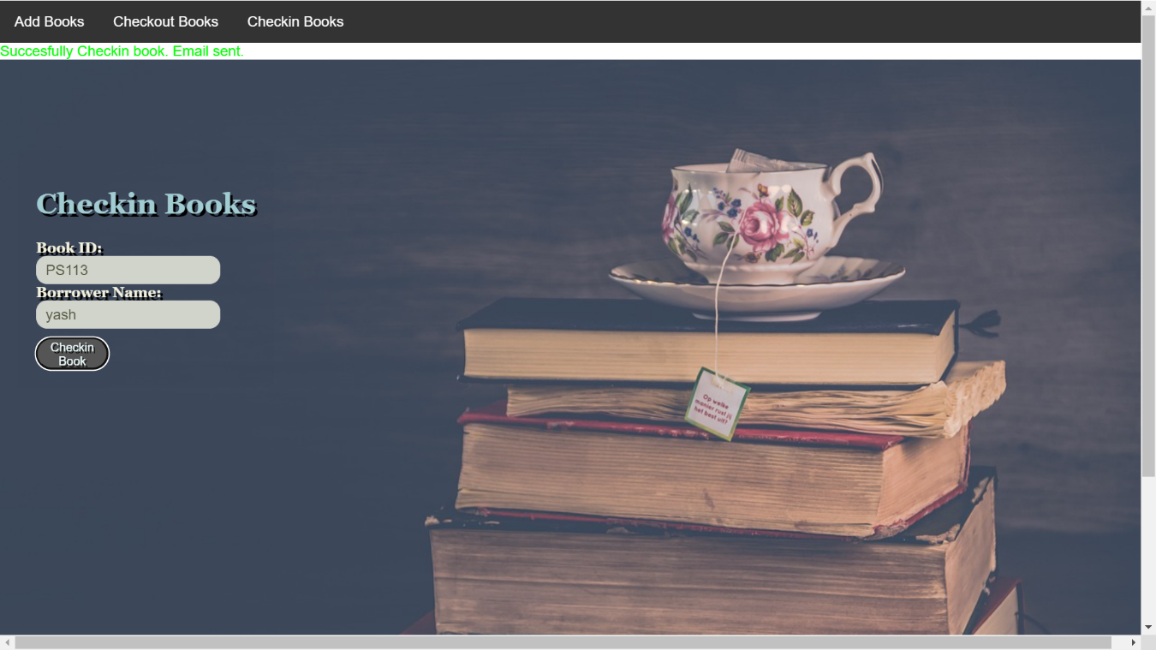
Results/Screenshots
CheckIn Book:

Slide 15

Results/Screenshots
Book already CheckedIn:

Slide 16
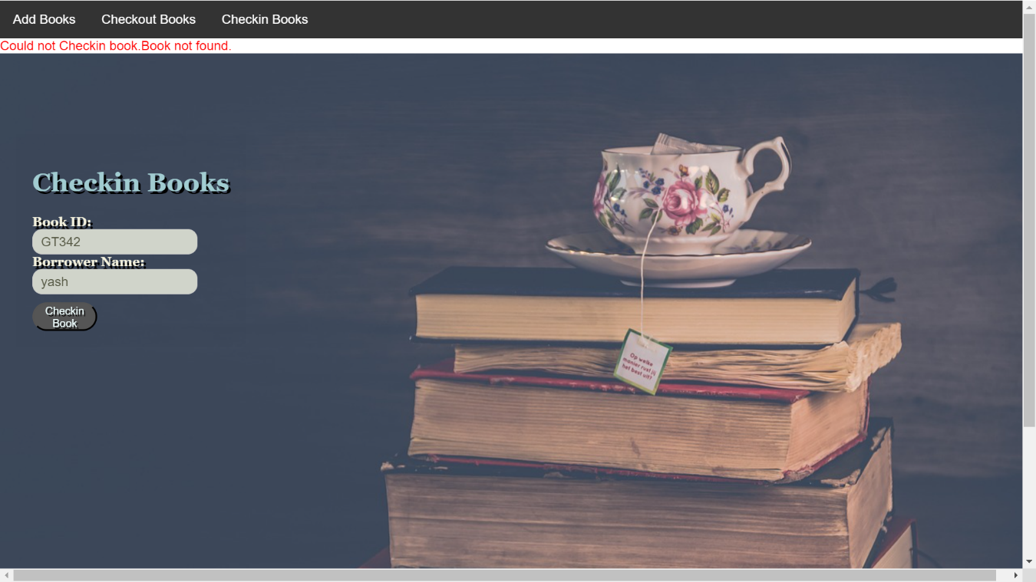
Results/Screenshots
Book not found for CheckIn:

Slide 17
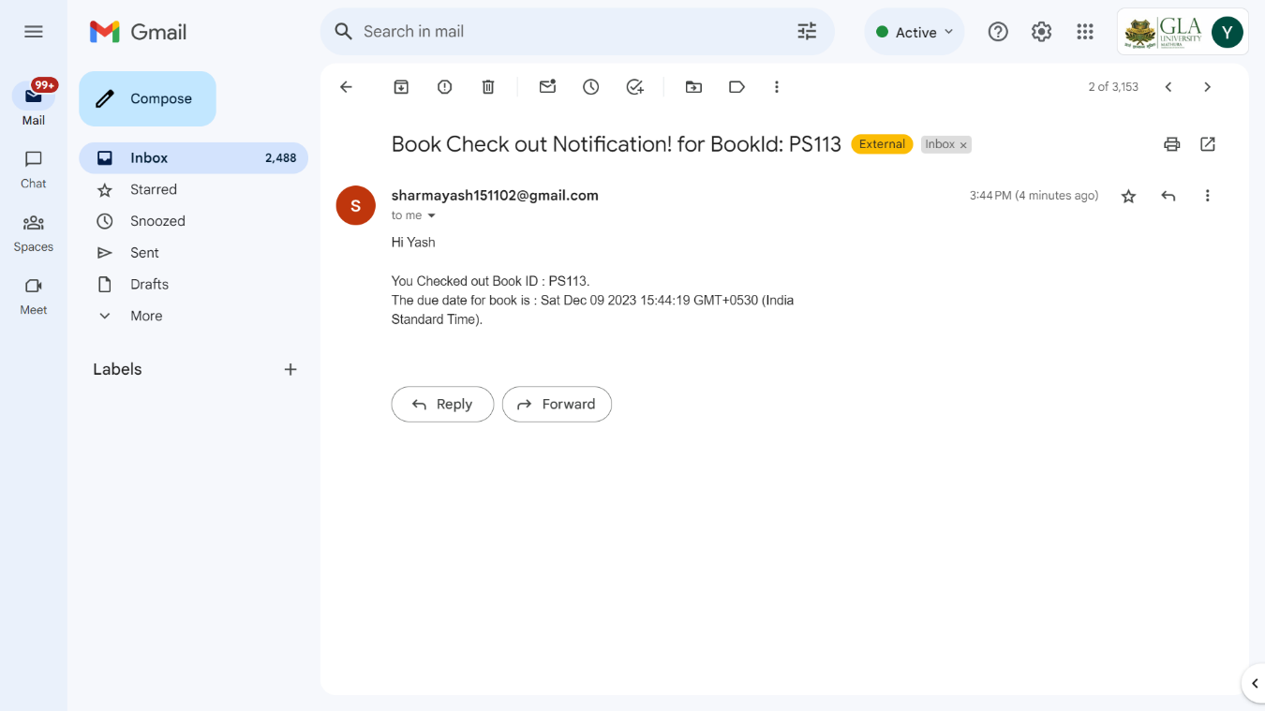
Results/Screenshots
Checkout notification Email:

Slide 18
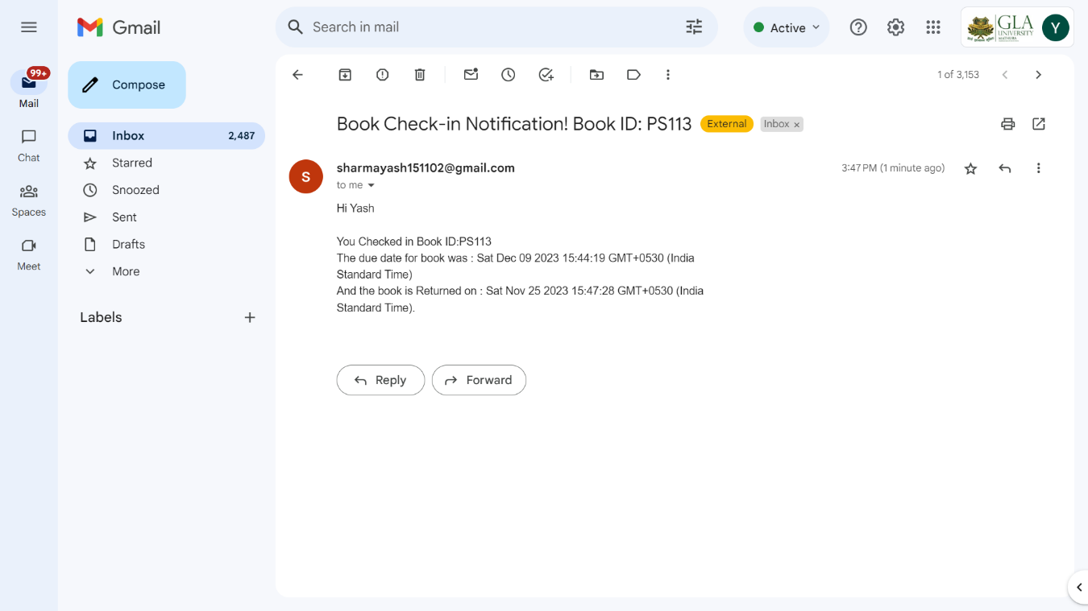
Results/Screenshots
Email CheckIn Notification:

Slide 19
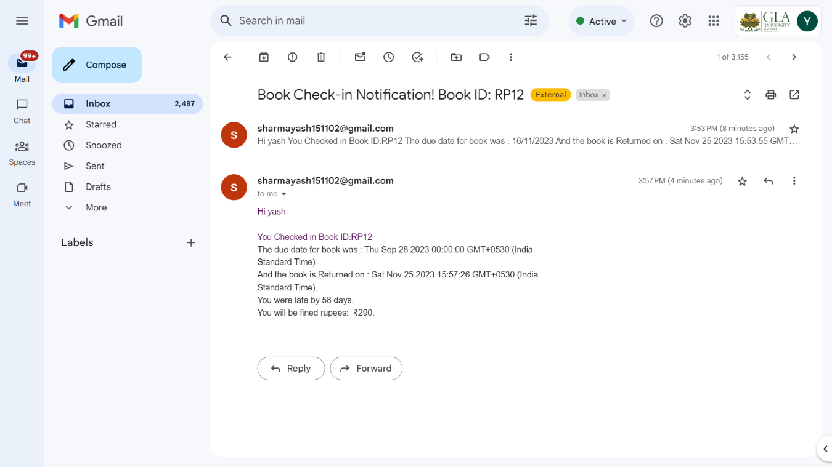
Results/Screenshots
Email CheckIn Notification with Fine calculation:

Slide 20
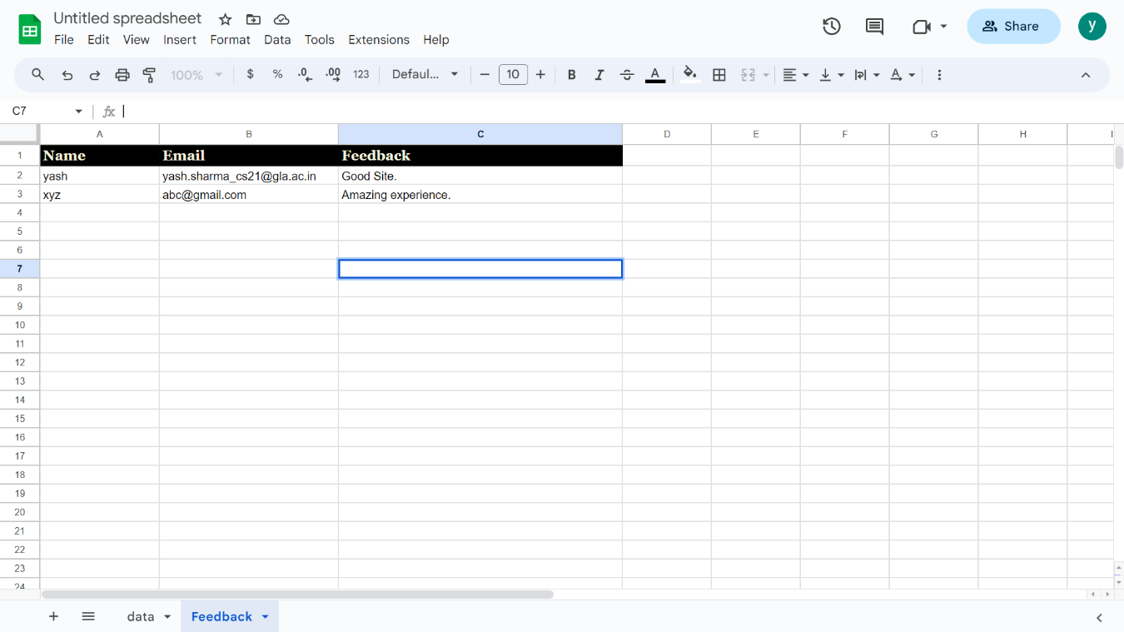
Results/Screenshots
Feedback Display page:

Slide 21
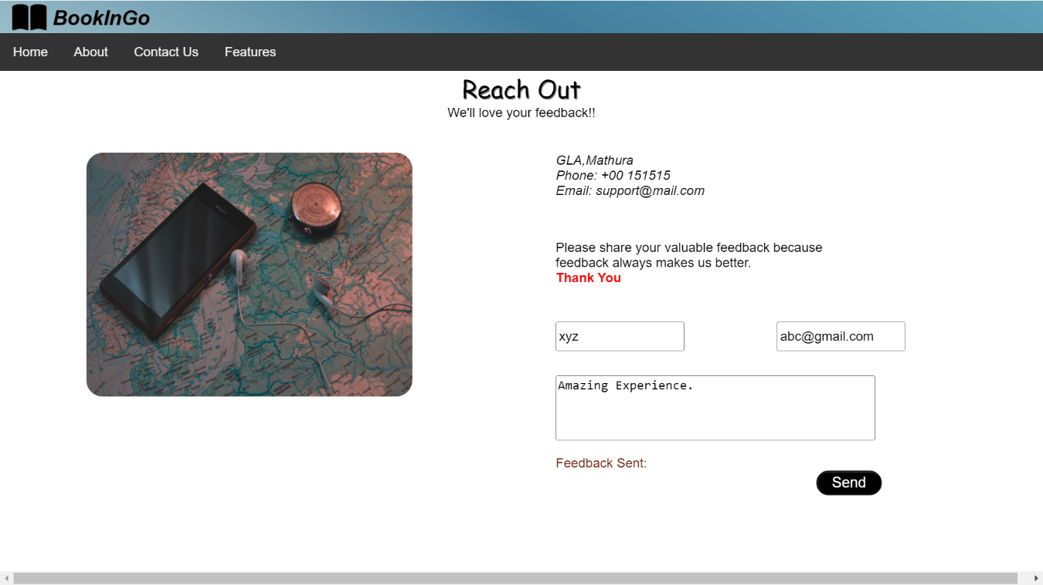
Results/Screenshots
Feedback Sent popup:

Slide 22
Challenges Faced
Stuck some time while coding but took help from YouTube, W3Schools,etc and multiple websites.
Learned so many new concepts while implementing the applications
Building an application from scratch has helped in improving coding skills.

Slide 23
Future Work
For BookInGo, will try to create the database where in data will be manipulated dynamically and more valdidations can be added in this LMS feature in future.

Slide 24
Conclusion
The LMS is much more user-friendly, faster in operation and easy to manage than the manual one. Problem Statement: The current library system is outdated and inefficient. There is a lack of organization in book management, book borrowing.The main purpose of a library management system is to manage & track the daily work of the library such as issuing books, return books, due calculations, etc.

Slide 25
Acknowledgments
Thanks to all the teachers and supervisior who was available everytime and provided there precious time while building this application.

Slide 26
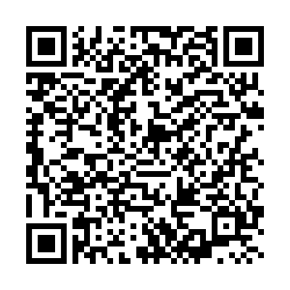
Thank You

